Slide 1
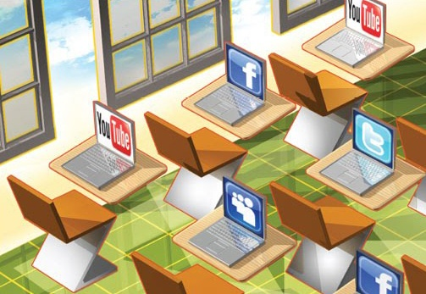
Social Media: the Classroom and Beyond #socialmedia http://youtu.be/57dzaMaouXA

Slide 2
A double-edged sword

Slide 3
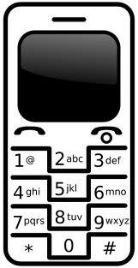
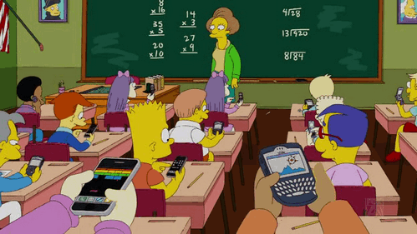
86% of all college students say the text in class.
69% say they access a social media website while in class.
Average student checks their cell phone 11 times per day in class.

Slide 5
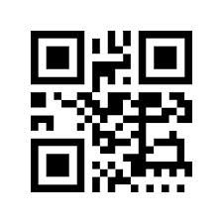
Classroom dilemma? https://www.youtube.com/watch?v=KiG6_H-uQKM
TED Ed
Socrative
Google Docs
Flip Classroom
Educlipper
Classdojo
Touchcast
Metta
Brickflow
Flubaroo
Sidevibe
Remind 101

Slide 6
Socialnomics
http://youtu.be/x0EnhXn5boM
Link to Social Media Sites
http://traffikd.com/social-media-websites/

Slide 7
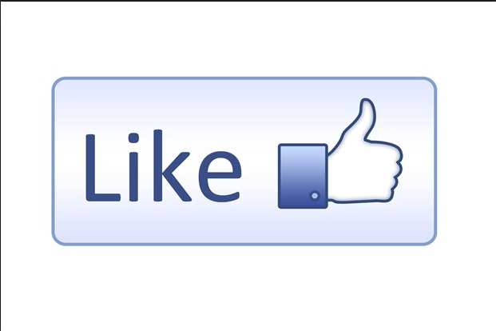
Generation Like
https://www.youtube.com/watch?v=TNzSip6B8sI

Slide 8
Look Up
http://youtu.be/ZS9Wte1gX9g

Slide 9
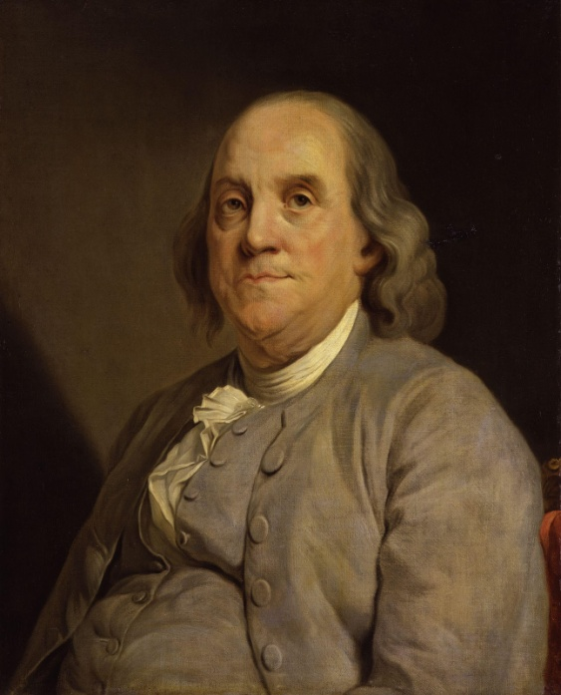
Mini-History of Social Media

Slide 10
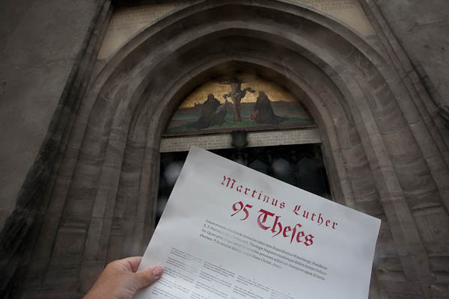
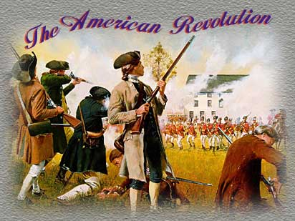
Methods Change, but …
How did these men and their methods of movement of information affect history?
The Printing Press
Martin Luther
The Postal Service
Benjamin Franklin

Slide 11
Methods Change, but …
Radio Free Europe
U.S.Congress established in 1949 to disseminate information to Eastern Europeans to combat Soviet propaganda
Voice of America
Has been around since early in WWII and now broadcasts in 53 languages around the world. It’s focus is cultural as well as political.
Xerox machines were smuggled behind the Iron Curtain to print anti-government information!

Slide 12
No matter what the method
Text messaging
E-mail
Photo sharing
Social networking
Facebook
Twitter
Vine
Snapchat
Blogging
Instagram….. And on and on and on!!!

Slide 13
Text Messaging
In 2001 Philippine President Joseph Estrada’s not guilty verdict for impeachment led to a public outcry through a massive texting campaign. The verdict was reversed.
In 2004 Prime Minister of Spain Jose Maria Aznar was ousted from office by a well-organized text messaging campaign led to massive demonstrations against his government.

Slide 15
Global Social Media
China has RenRen (Facebook of China), Weibo for blogging in China. Taiwan has Wretch and Japan has become a Twitter nation quickly. Read more: Social Media In Asia [INFOGRAPHIC] http://www.techinasia.com/social-media-in-asia/

Slide 16
Social Media in China
Wechat is the number one social mobile app in China in terms of effective usage time, followed by Sina Weibo, Qzone, Baidu Tieba and Renren app according to iResearch data in April 2014.
Social media traffic on mobile apps has exceeded desktop traffic in China in the first quarter of 2014.

Slide 17
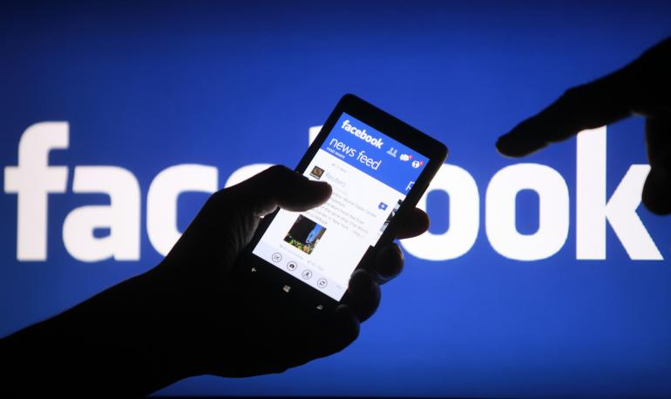
Facebook is still the most popular site with 127 out of 137 countries analyzed: in the latest months Facebook lost Kyrgyzstan, but stole Syria from Maktoob. Facebook has now 1,189 billion monthly active users, but it is growing less rapidly than before (it has added just 34 million active users in 6 months). 351 million users in Asia, 276 million in Europe, 199 million in US & Canada, 362 million in remaining countries (according to Q3 2013 Earnings)

Slide 18
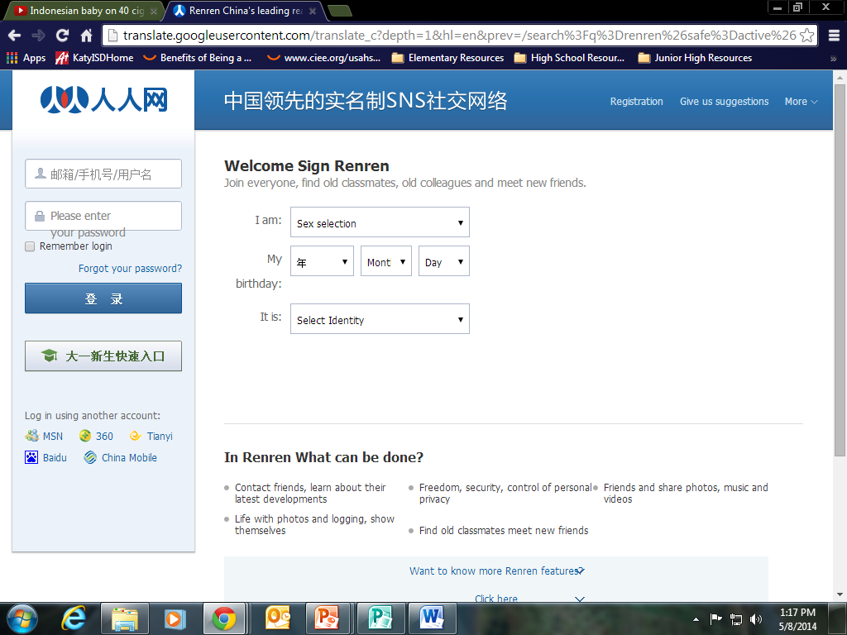

Slide 19
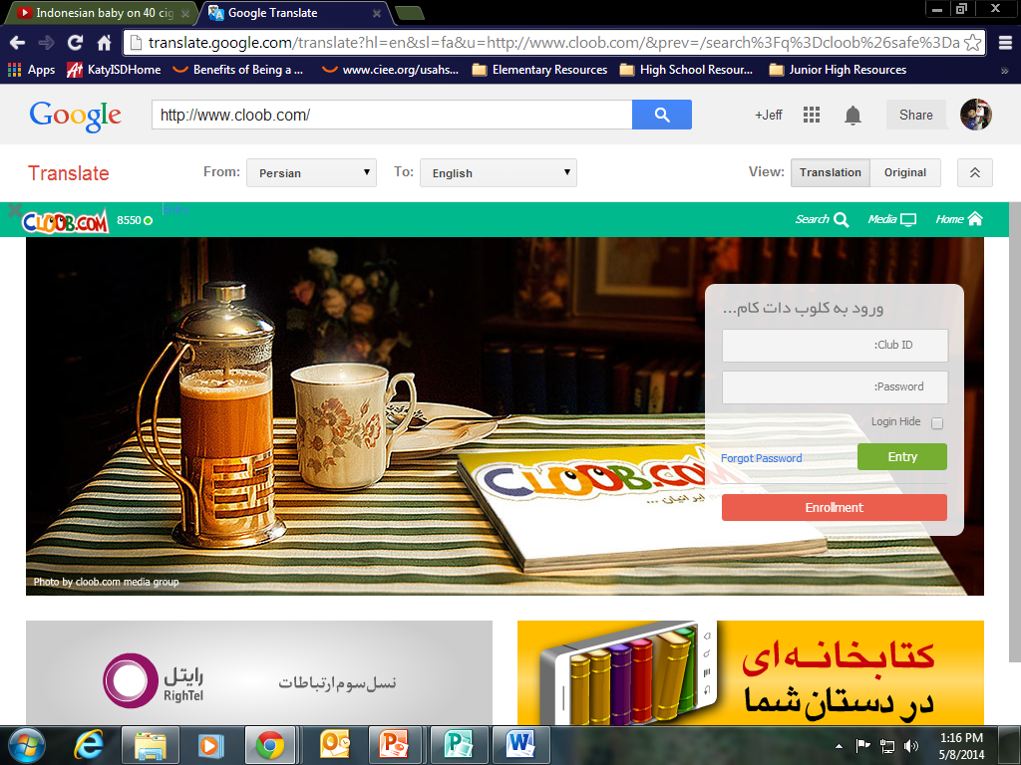

Slide 20
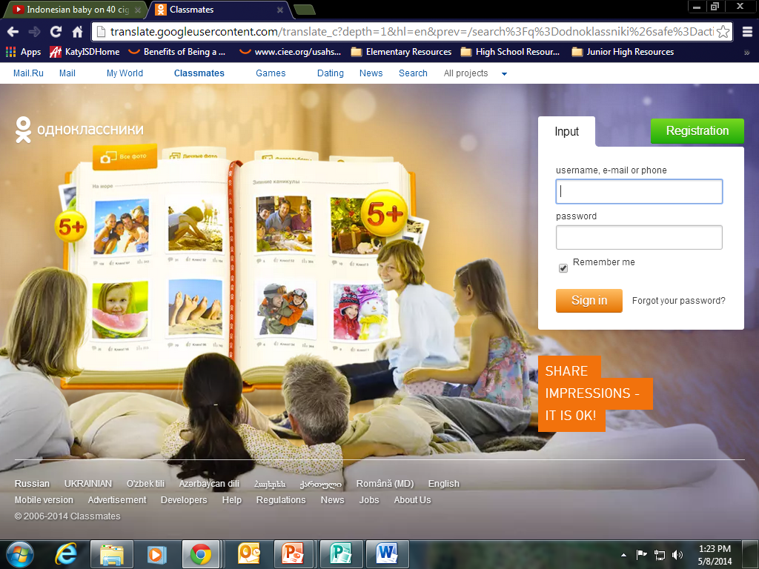

Slide 21
The Arab Spring and Beyond

Slide 22
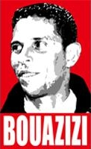
Mohamed Bouazizi
How did this Tunisian fruit vendor spark the Arab Spring?
Cell phone videos and pictures of his death were put on Twitter and Facebook and spread to the Arab world.
Egyptian government tried shutting down the internet but Google and Twitter were able to set up a voice activated transmission. http://youtu.be/vfq7gyKHIwc

Slide 23
Can you say “Happy”
https://www.youtube.com/watch?v=taGf9T7I1h4

Slide 25
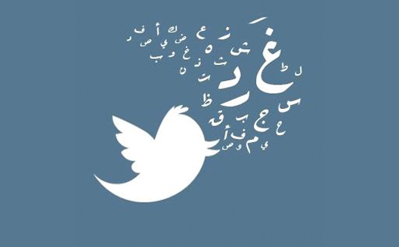
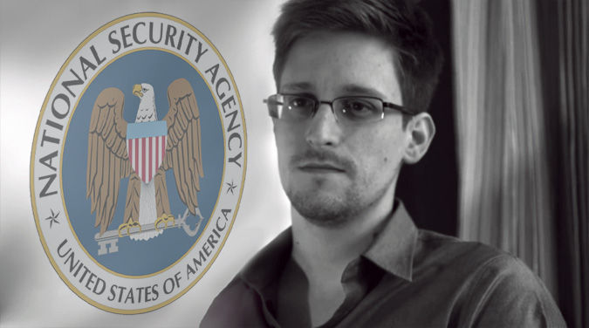
It is impossible to put back in the bottle.
What does this mean for countries who want to control their people?
Or maybe monitor their people?

Slide 26
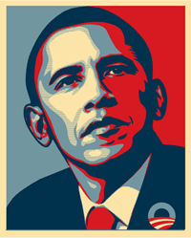
President Obama’s election in 2008
Facebook co-founder Chris Hughes was a key strategist.
Obama won 70% of the under 25 vote with the most extensive social media campaign ever used in a presidential election.

Slide 27
Kony 2012

Slide 28
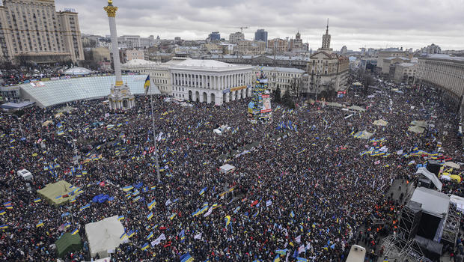
Ukraine and “Euromaidan”
“Euromaidan” was the term used to organize a major demonstration in Independence Square in Kiev in January 2014.
Euromaidan was blasted through social media by Facebook and Twitter.

Slide 29
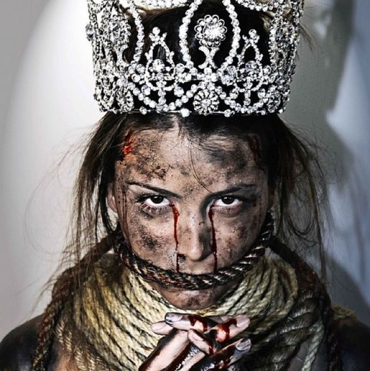
Venezuela
Former Venezuelan Miss Universe Stefanía Fernández has gone public to expose the lack of freedoms and violence in Venezuela over the past few months.

Slide 30
Cracks in the walls
North Korea
Hundreds of thousands of cell phones are being smuggled in as the new currency is “information.” http://www.pbs.org/wgbh/pages/frontline/secret-state-of-north-korea/
www.libertyinnorthkorea.org
China
70,000 protests a year take place and officials find it very difficult to filter and or block information.
What do authoritarian states fear?

